Slide 1
Data passing between screens

Slide 2
Main content
Public static member
Constructor parameter & Public property
Delegate & event

Slide 3
Public static member

Slide 4
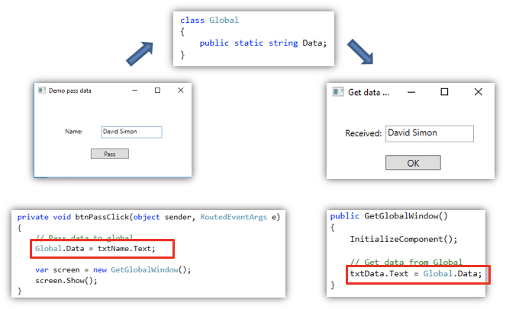
Example

Slide 5
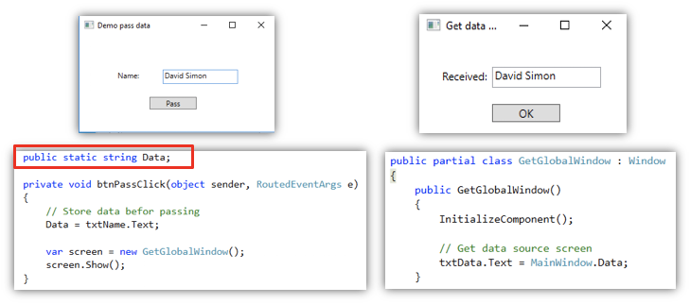
Thêm thành phần tĩnh cho màn hình đích

Slide 6
Constructor’s parameter & public property

Slide 7
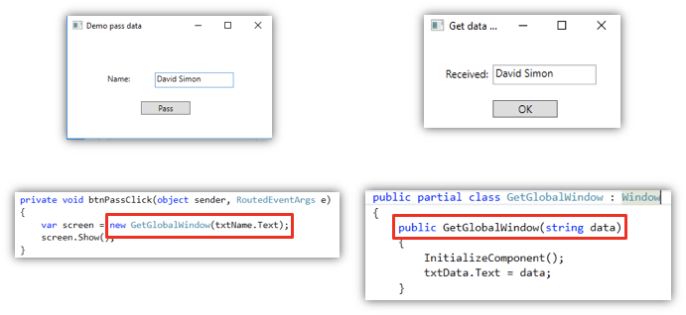
Using constructor to pass data

Slide 8
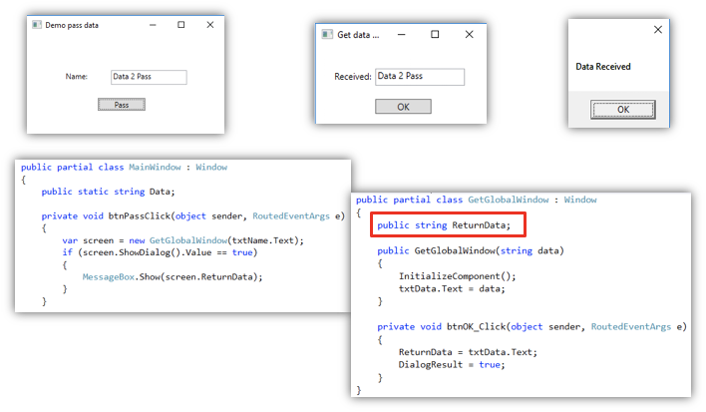
Get data back using public property

Slide 9
Delegate & Event

Slide 10

What is delegate?
Type of function
Can be considered data type

Slide 11
Quiz: Which functions satisfy the Calculator type?
void checkCoexist(int a, int b)
int Multiply(int a, int b, int c)
int Power(int a, int b)
bool IsPrime(int a)

Slide 12
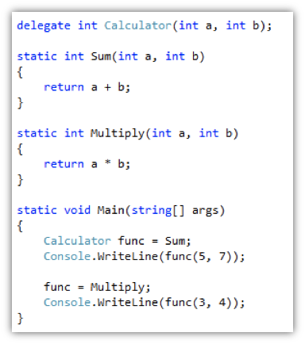
Basic examples

Slide 13
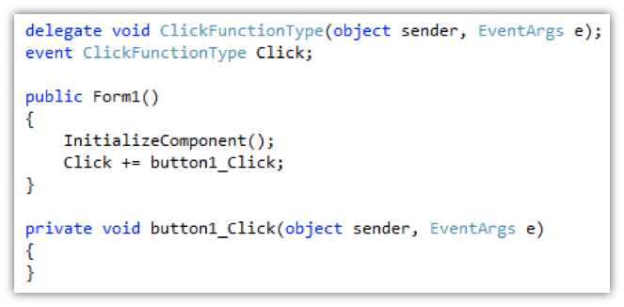
What is event?
Array of pointer functions

Slide 14
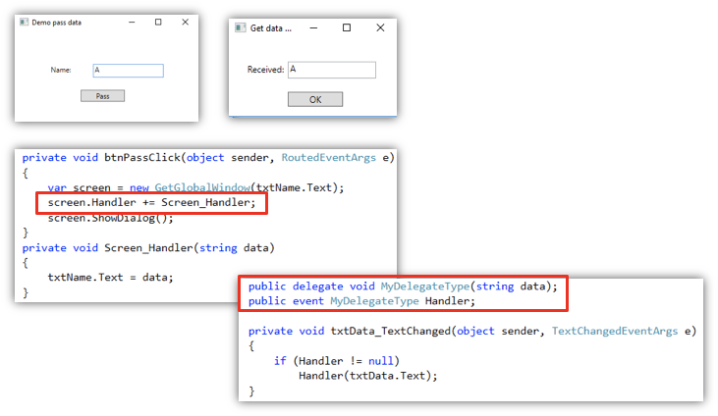
Using delegate & event for receiving data in real time

Slide 15
Exercise
Create a TODO app
There will be a list of tasks that need to be done
1. Create a button to add a new task from another window
2. Edit a selected task in another window
Try passing a TodoTask object rather than a string to learn more about reference

Slide 16
Problem - Restore back using backup?
Step 1: Store a backup clone of current object
Step 2: Update real time property on current object
Restore back if necessary
Step 3: Copy all newly updated properties to current

Slide 17
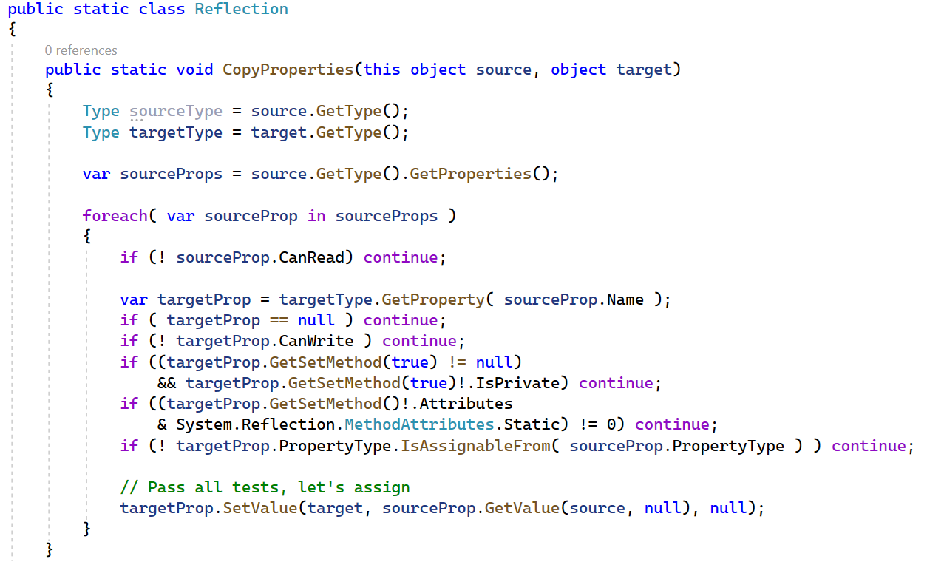
Extension class for copy values - Warning: Shallow
Notes:
public static class Reflection
{
public static void CopyProperties(this object source, object target)
{
Type sourceType = source.GetType();
Type targetType = target.GetType();
var sourceProps = source.GetType().GetProperties();
foreach( var sourceProp in sourceProps )
{
if (! sourceProp.CanRead) continue;
var targetProp = targetType.GetProperty( sourceProp.Name );
if ( targetProp == null ) continue;
if (! targetProp.CanWrite ) continue;
if ((targetProp.GetSetMethod(true) != null)
&& targetProp.GetSetMethod(true)!.IsPrivate) continue;
if ((targetProp.GetSetMethod()!.Attributes
& System.Reflection.MethodAttributes.Static) != 0) continue;
if (! targetProp.PropertyType.IsAssignableFrom( sourceProp.PropertyType ) ) continue;
// Pass all tests, let's assign
targetProp.SetValue(target, sourceProp.GetValue(source, null), null);
}
}
}

Slide 18
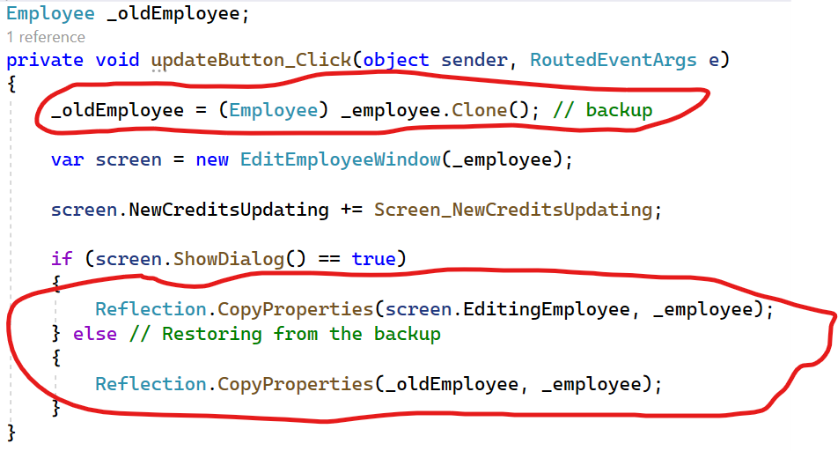
Full flow for preview - update - backup & restore

